Slide 1
Semiconductor Memory
Section 0-3

Slide 2
Some terminology
Bit 0
Nibble 0000
Byte 0000 0000
Word 0000 0000 0000 0000
Kilobyte 1024 bytes = 2^10 bytes
Megabyte 1048576 bytes = 2^20 bytes
Gigabyte = 2^30 bytes
Terabyte = 2^40 bytes

Slide 3
Internal Organization of computers
3 major subsystems
CPU – Central Processing Unit
Memory
I/O Input Output
Connected by buses
Data
Address
Control

Slide 4
Computer Block Diagram
Address Bus
CPU
RAM
ROM
Printer
Disk
Mon
Keyboard
Data Bus
Control Buses (MEMR, MEMW, IORD, IOWR)

Slide 5
More About the Data Bus
Analogous to Highway
The more lanes, the more simultaneous traffic
The more data buses the better
This adds to expense
Note that we currently have 64 bit CPUs and operating systems
The size of the data bus is related to both size and precisions of arithmetic operations

Slide 6
More About the Address Bus
Every addressable device must have a unique address
The larger the address bus, the larger number of devices which may be addressed by the CPU
Recall that decoders are used on addressable device to establish their address.
The number of devices which may be addressed is always equal to 2^x where x is the number of address lines.
For example, a 16 bit address bus can access 64k of addressable memory
This is a unidirectional bus (send only from CPU)

Slide 7
Relation of CPU to RAM and ROM
The CPU processes information that is stored in Memory
ROM (Read Only Memory) stores information that is fixed and permanent
Information Tables
Essential Programs
RAM (Random Access Memory) stores temporary information which may change over time.
Application Programs
Operating Systems
This information is accessed from memory because accessing the disk is too slow.
The CPU tries to access RAM and ROM first (primary memory)
Disk Second (Secondary Memory) to transfer to RAM

Slide 8
Memory Capacity
This is the number of bits a memory chip can store
Chip capacity has units of bits, Computer system capacity has units of bytes

Slide 9
Memory Organization
Memory chips are organized into a number of locations within the IC
Each location can hold 1, 4, 8, 16, or more bits
The number of bits that each location will hold is equal to the number of data pins on the chip.
The number of locations on the chip is determined by the number of address pins on the chip say x. 2^x is the number of locations (addresses) on the chip
Total number of bits which may be stored on the entire chip is given by 2^(address pins) times the number of data pins

Slide 10
Organization/Capacity Example
A particular memory chip has 16 address pins and 8 data pins
Organization: 2^16 locations of 8 bits 64K x 8
Capacity: 2^16 * 8 131072 bits

Slide 11
Another Organization/Capacity Example
We have a chip with 256k capacity with 8 data pins.
The organization is 256k/8 = 32K x 8
The number of address lines is 15 since 2^15 = 32K

Slide 12
Need for Speed
This is one of the most important aspects of a memory chip
Accessing the data:
Present address
Enable read pin
Delay
Data available
The delay is the chips access time or speed
Higher speed is typically more expensive than lower speed

Slide 13
ROM (read only memory)
Does not lose its contents on loss of power
Also called nonvolatile memory
Different types such as:
PROM
EPROM
EEPROM
FLASH EPROM
MASK PROM

Slide 14
PROM (programmable ROM) and OTP
This is the type of ROM that the user can burn information into
Programmable by user
A fuse exists for each bit in the PROM
Programming consists of blowing the fuse.
This act may not be changed once accomplished so it is also called One Time Programmable OTP
Burning the Rom requires special equipment called a ROM burner or ROM programmer

Slide 15
EPROM (erasable programmable ROM) and UV-EPROM
Different than OTP in that a particular chip may be programmed on the order of a thousand times.
Useful in development activities where changes are usually encountered.
UV-EPROM is a widely used technology where ultra violet radiation is exposed to the device through a window on the chip to erase is contents, which takes about 20 minutes to accomplish.
To program a UV-EPROM
Erase the chip. (Even if it is new)
Program the chip using the ROM burner
Replace the chip into the system socket

Slide 16
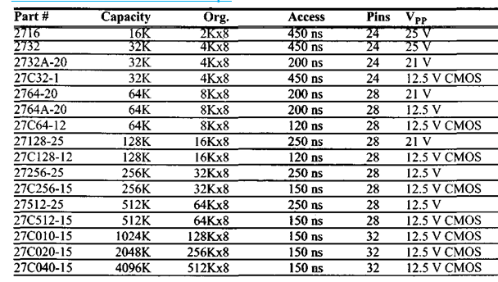
Some UV-EPROM Memory Chips
For example, 27C256-15 is CMOS, with 256k capacity with 15 ns
access, and 32k x 8 organization.

Slide 17
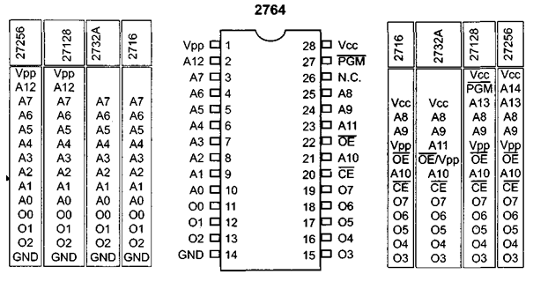
27xx ROM family pin outs

Slide 18
Example of 27xx pins comprehension
Find the number of address and pins on 27256 ROM.
27256 has capacity of 256k and 32k x 8 organization
Note that all ROMs have 8 data pins
Thus there are 15 address pins (2^15 = 32K)
Note the previous slide to confirm A0 thru A14

Slide 19
EEPROM (electrically erasable programmable ROM)
Advantages compared to EPROM
Method of erasure is instantaneous.
Can selectively erase bytes
Disadvantages compared to EPROM
Additional programming circuity required on system board
Cost per bit is much higher

Slide 20
Flash Memory EPROM
Method of erasure is electrical
Takes less than a second to erase
Contents may be erased block by block
Widely used to update BIOS ROM of the PC
As of 2015, most solid state drives used nand gate based flash memory
Access time of Flash Memory is on the order of 100 ns

Slide 21
Mask ROM
Contents are programmed by manufacturer
Not user programmable
Mask refers to a fabrication step
Costly Process
Requires high volume
Requires extremely low risk of change
Results in low variable cost per device
Conforms to 8 data pin standard for ROM

Slide 22
Ram (random access memory)
This is referred to as volatile memory because it loses data when it loses power. Also know as RAWM (read and write) memory
3 types
Static RAM
Nonvolatile RAM
Dynamic Ram

Slide 23
SRAM (static RAM)
The storage cells are made up of flip-flops and thus do not require refreshing to keep their data,
This a key advantage of SRAM
On the other hand,
Two many transistors are required for implementation which make this type of memory lower in capacity compared to other technologies.

Slide 24
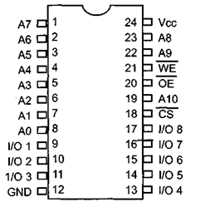
2k x 8 SRAM pin out and block diagrams

Slide 25
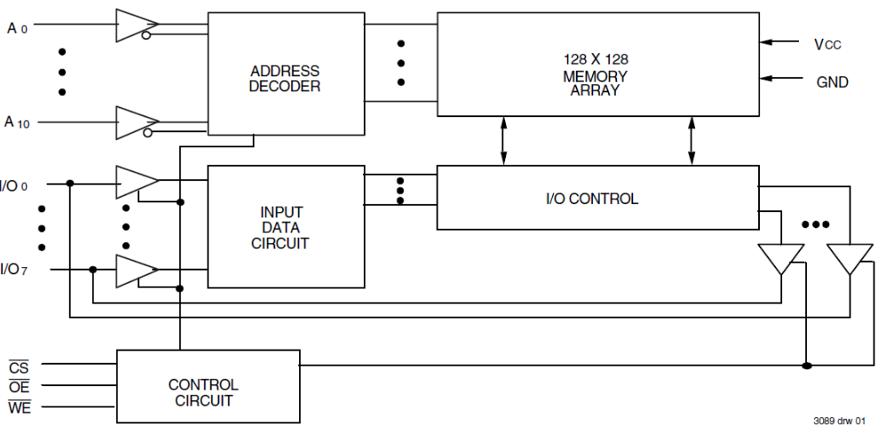
6116 SRAM Block Diagram

Slide 26
Steps required to write data into SRAM
Provide the addresses into pins A0 – A10
Activate the CS pin
Make WE = 0 while RD = 1
Provide data to IO0 to IO7
Make WE = 1 and data will be written on the positive edge of the WE signal

Slide 27
Steps required to read data from SRAM
Provide the addresses to pins A0 – A10
This is the start of the access time
Activate the CS pin
While WE = 1 a high to low pulse on the OE pin will read the data out of the chip

Slide 28
NV-RAM (nonvolatile RAM)
This type of RAM retains its contents when the power is lost.
It does this by using an internal lithium battery as a back up power supply
This accomplished by control circuitry on each chip to detect a drop in Vcc
It can retain its info for up to 10 years
SRAM cells are made from CMOS which has very low power consumption
One can read it or write to it in the same way as SRAM
It is very expensive comparatively as far as cost per bit is concerned

Slide 29
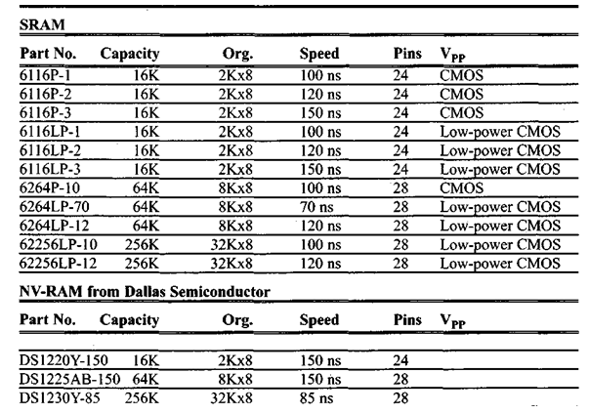
Some SRAM and NV-RAM examples

Slide 30
DRAM (dynamic RAM)
Computer designers have needed large amounts of inexpensive read/write memory since the original computers were developed
In 1970 Intel introduced the first dynamic ram
Its density was 1k bits
It used a capacitor to store each bit
Use of capacitor is simpler than groups of transistors
But this requires the data to be refreshed due to leakage currents

Slide 31
DRAM (dynamic RAM) Pros and Cons
Advantages
High Density
Lower Cost per bit
Lower Power Consumption per bit
Large capacities of 2 Gigabit and more are now common
Disadvantages
Memory must be periodically refreshed
Memory can not be accessed during refresh operation

Slide 32
DRAM Packaging
It is difficult to keep a reasonable number of pins in the face of large capacity DRAMs
As a result multiplexing and demultiplexing is used to reduce required pin count
One method of accomplishing this is to split the address in half and send each half through the same pins
The first half is referred to as the row, and the second half is referred to as the column
In the case of 64K x 1 organization the RAS is activated to latch the first 8 bits of the address, then the CAS is activated to latch the second 8 bits or octet
In order to reduce complexity, many small capacity microcontroller projects will use SRAM or NV-RAM instead of DRAM

Slide 33
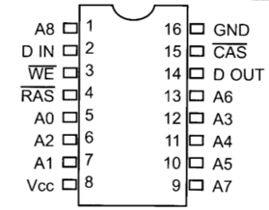
DRAM organization
May be x1, x4, x8, or x16
Data pins may be also called I/O
Note the below example of 256k x 1 DRAM with pins A0 – A8, RAS, CAS, Data in, Data Out, Vcc, and Ground.

Slide 34
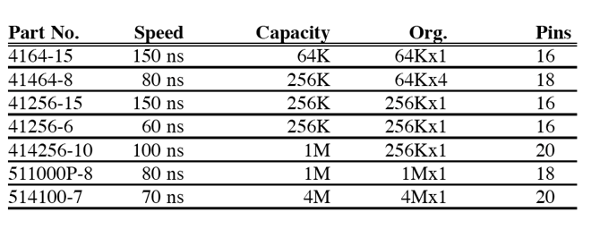
Example DRAM Memory Chips

Slide 35
Comparison of DRAM and SRAM
Consider an organization of 16k by 4
Recall that 2^14 = 16k
DRAM
7 address pins (A0 – A6)
2 pins for RAS and CAS
4 pins data bus
SRAM
14 address pins (A0 – A13)
No RAS or CAS
4 pins data bus

Slide 36
Memory Address Decoding
Consider an SRAM..
These will have a CS (chip select) or CE (chip enable) pin
Connecting to CPU
Data bus is connected directly
Control Signals RD (read) and WR (write) are respectively connected to the OE (output enable) and WE (write enable) pins of the memory device
For address buses, the lower bits of the address bus go directly to the address pins on the device, but the higher ones are used to activate the CS pin via decoding logic.
Normally the CS pin is active low and memories are divided into blocks. The output of the decoder selects a given block

Slide 37
Memory Block Selection
Simple Logic Gates
Using 74LS138
Programmable Logic such as CPLD or FPGA

Slide 38
Simple Logic Gate Address Decoder
The simplest method is to us a NAND gate decoder..
The out put of a NAND gate is active low.
Most Chip Select Pins are Active Low
If the CS pin is active high, an AND gate will be used instead
Any address range may be decode using the right combination of NAND gates and inverters
Note the example on the next slide
0011 on A12 – A15 will select the chip (Hex 3)
0000 0000 0000 on A0 – A11 results in hex 3000
1111 1111 1111 on A0 – A11 results in hex 3FFF

Slide 39
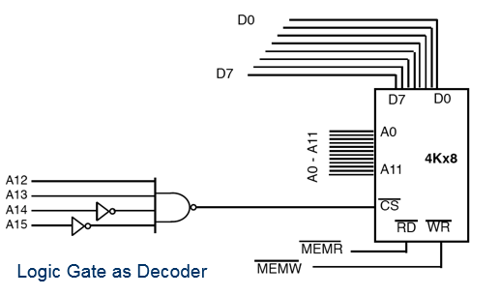
Simple Logic Address Decoder

Slide 40
Using the 74LS138 3 – 8 decoder
One of the most widely used decoders
3 inputs A, B, and C generate 8 active low outputs Y0 to Y7,
Each output is connected to CS of a different memory device allowing control of 8 memory blocks
Three additional inputs G1, G2A, and G2B may connected to an Address or Control Signal
G2A and G2B active low
G1 active high
These inputs must be terminated in way or another
These inputs enable the device

Slide 41
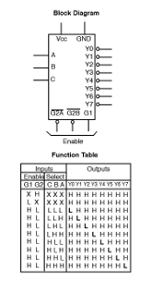
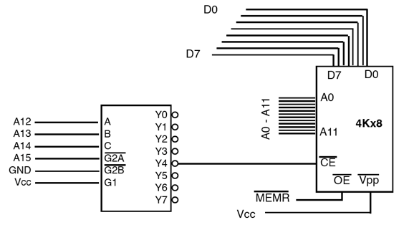
74LS138 pin out, function table, and schematic

Slide 42
74LS138 Example
What is the address range for Y5 in the previous slide?
A15 must be O for decoder to be activated since it is connected to G2A
C, B, and A are 101
The rest are either all 0 (low boundary) or all 1 (high boudary)..
0101 0000 0000 0000 or hex 5000 to 0101 1111 1111 1111 or hex 5FFF

Slide 43
Using Programmable Logic as Address Decoder
Devices include PAL, GAL, and FPGA
Advantages
May be programmed for any combination of addresses
Very versatile
More inputs available
Disadvantages
Additional Software Required
Additional Burner Required

